Slide 1
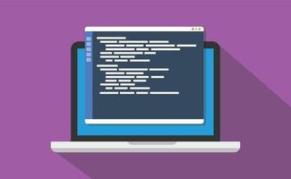
Text Editor
Presented by-
Group 16
46. Omkar Vitthal Savant
47. Diksha Pravin Sawant
48. Om Vilas Shimpi

Slide 2

Software Testing
Software testing is the process of evaluating and verifying that a software product or application does what it is supposed to do.
Types of Software Testing
Manual Testing
Automation Testing
Glenford J. Myers initially introduced the testing in 1979.

Slide 3
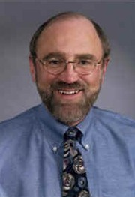
Glenford J. Myers

Slide 4


Java
Java is a high-level, class-based, object-oriented programming language that is designed to have as few implementation dependencies as possible.
It was designed by James Gosling in 1996
Sun Microsystems released the first public implementation

Slide 5
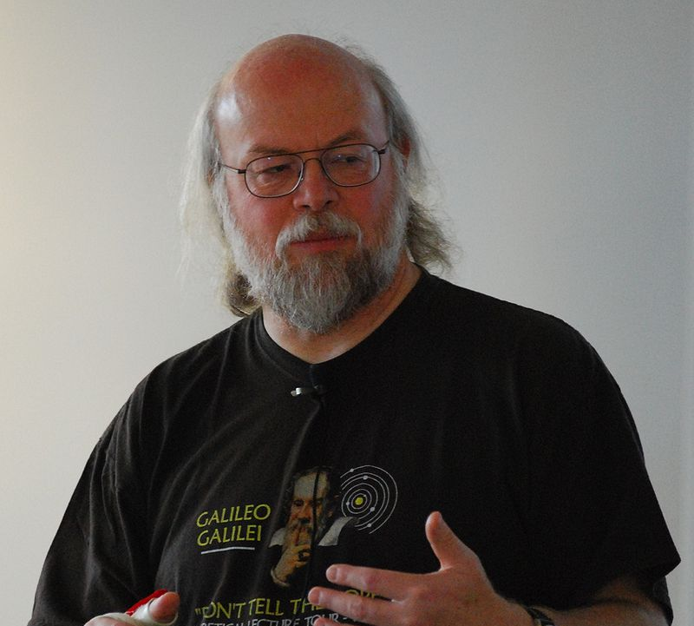
James Gosling

Slide 6
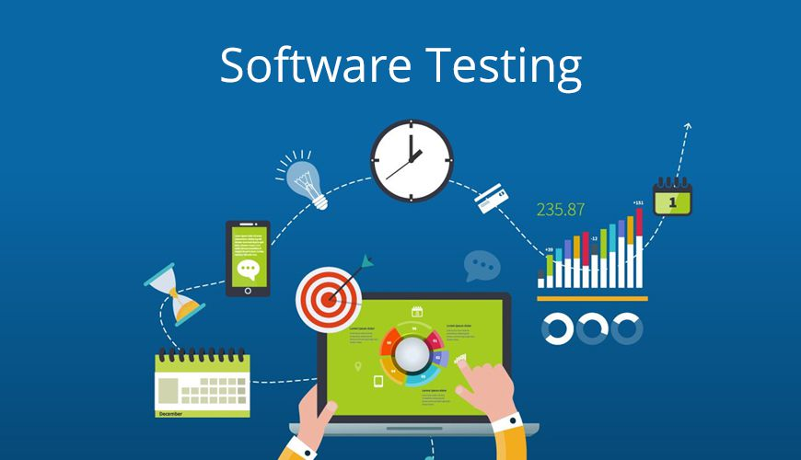
Types
Manual Testing
White Box
Black Box
Grey Box
Automation Testing

Slide 7
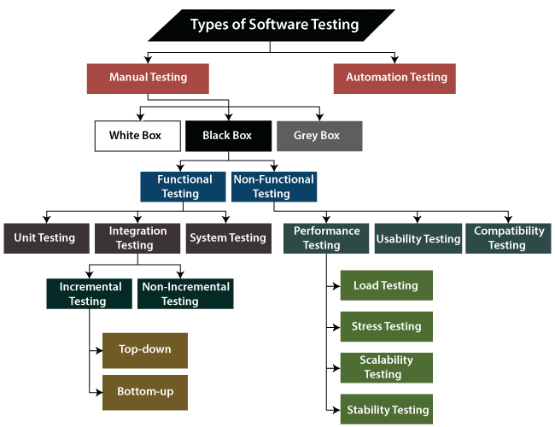

Slide 8
Software Requirements
Operating system : windows xp/7/8
Compiler used : java
IDE USED : Neatbeans
Front End : java, etc.

Slide 9
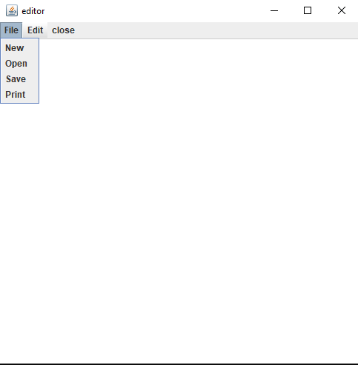
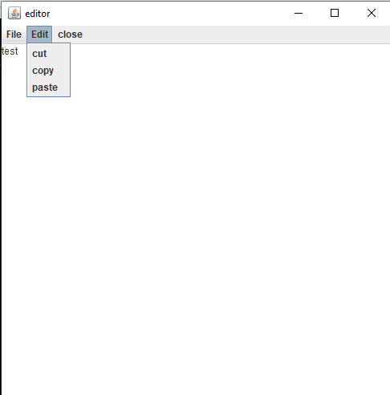
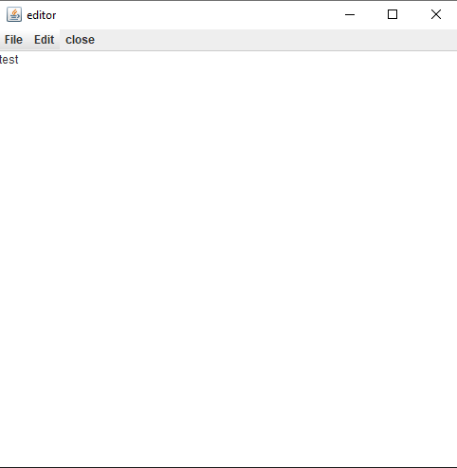
Output

Slide 10
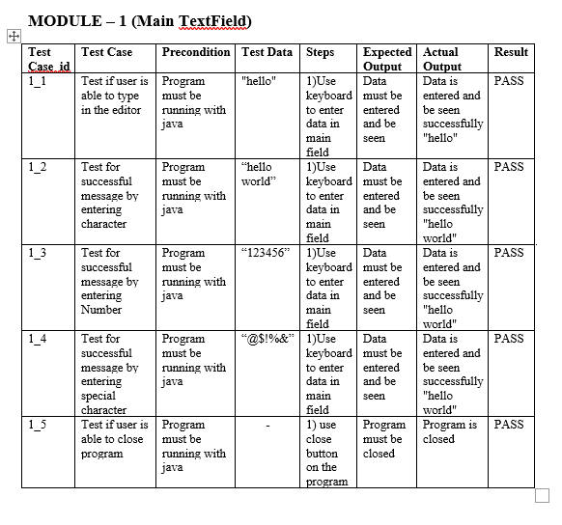
Test Cases

Slide 11
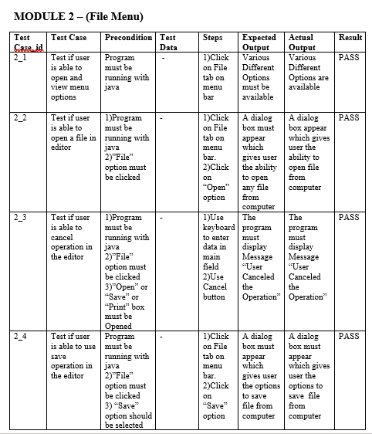
File Menu

Slide 12
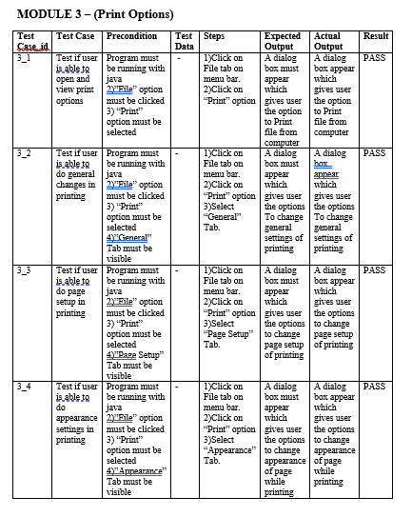
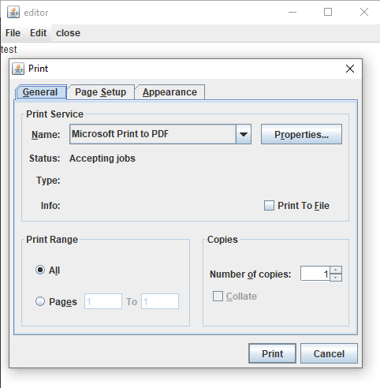
Print Options

Slide 13
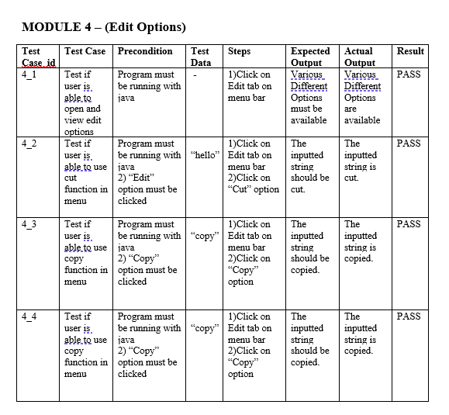
Edit Options

Slide 14
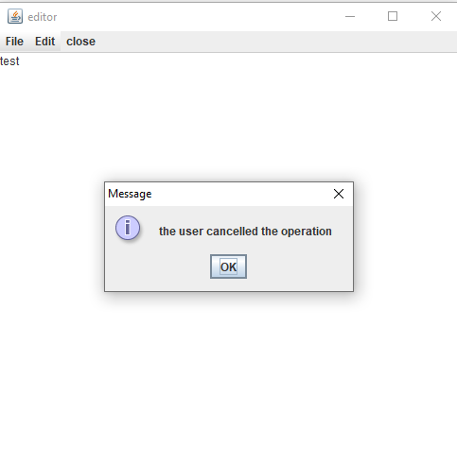
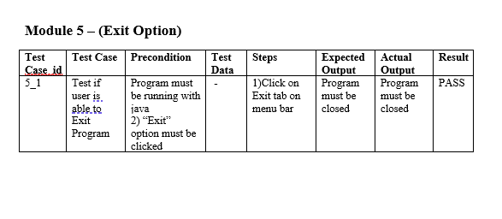
Exit Options

Slide 15
Advantages
Cost-Effective
Security
Product quality
Customer Satisfaction

Slide 16

Disadvantages
Heavy Documentation
Requires highly capable people
High amount of risk
Late Customer Involvement

Slide 17

Conclusion
A primary purpose of testing is to detect software failures so that defects may be discovered and corrected.
Text Editor as a project helped us to understand various concepts of java as well as software testing.

Slide 18

Thank You!

